Slide 1
UNIT 1
SNEHA GUPTA
DSA

Slide 2
Character arrays and strings

Slide 3
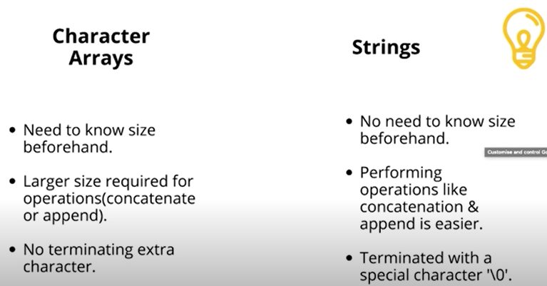

Slide 4
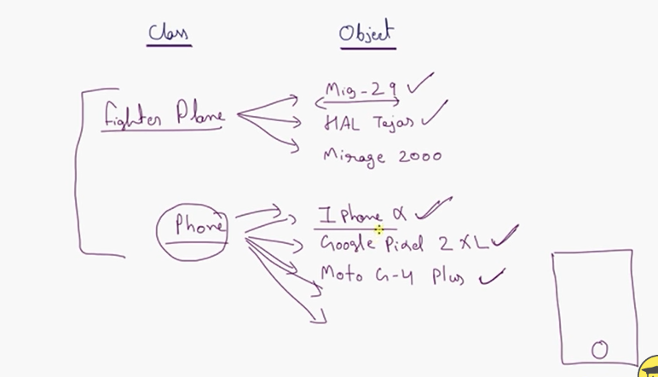

Slide 5
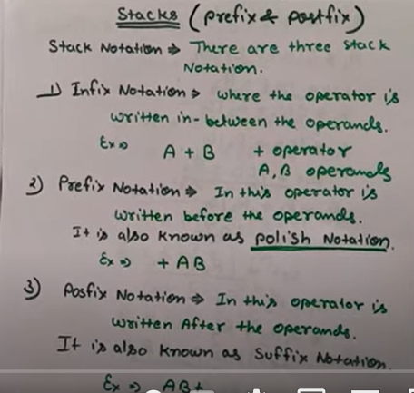

Slide 6
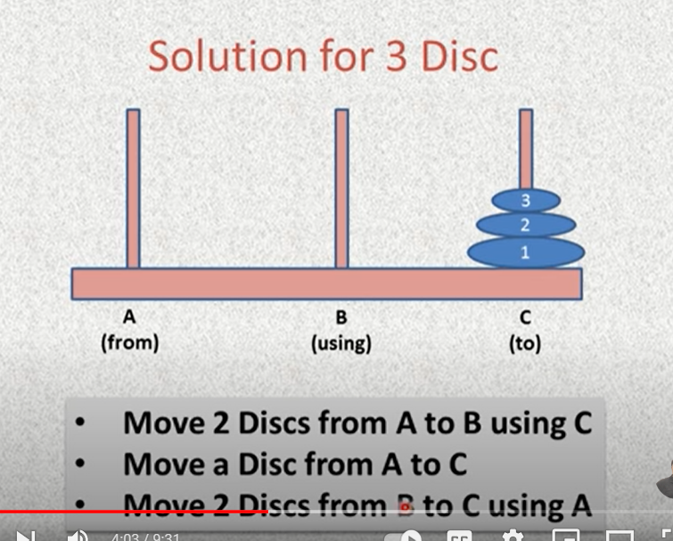

Slide 7
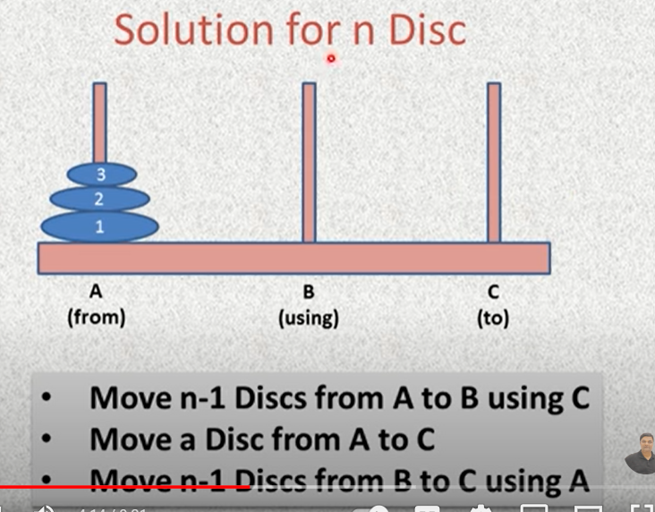

Slide 8
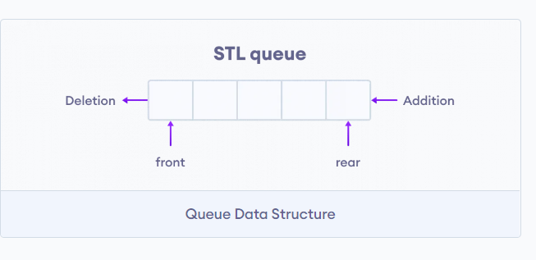

Slide 9
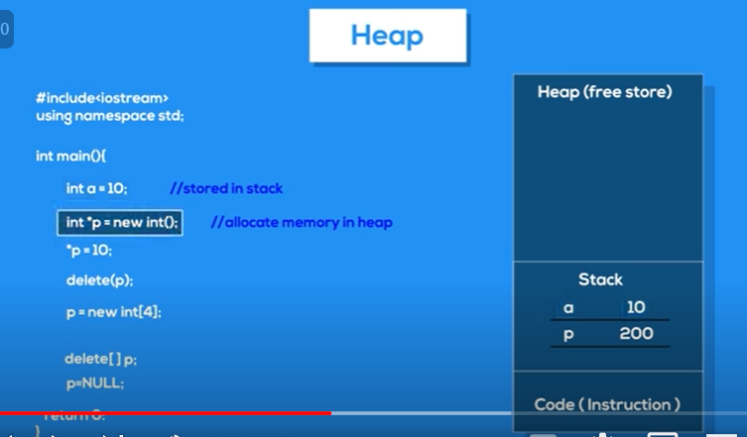

Slide 10
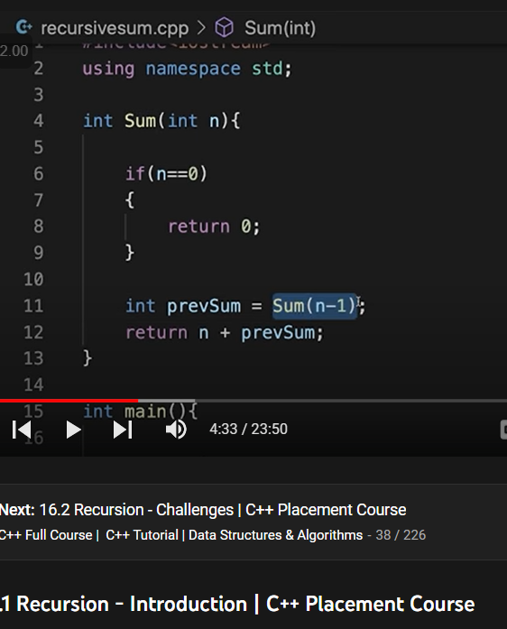

Slide 11


Slide 12
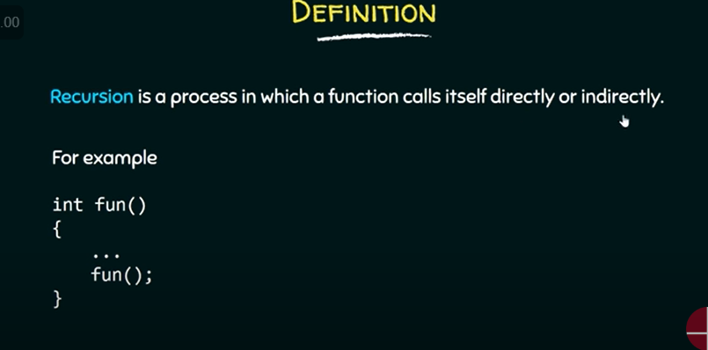

Slide 13
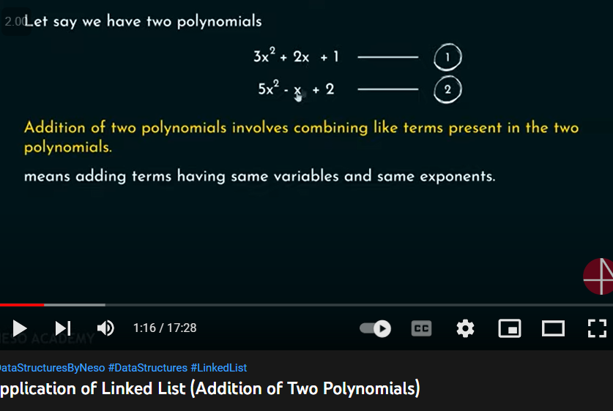

Slide 14
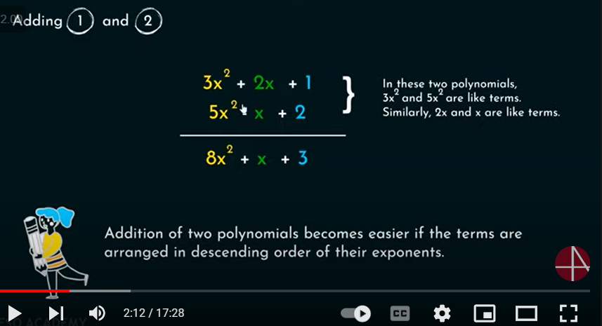

Slide 15
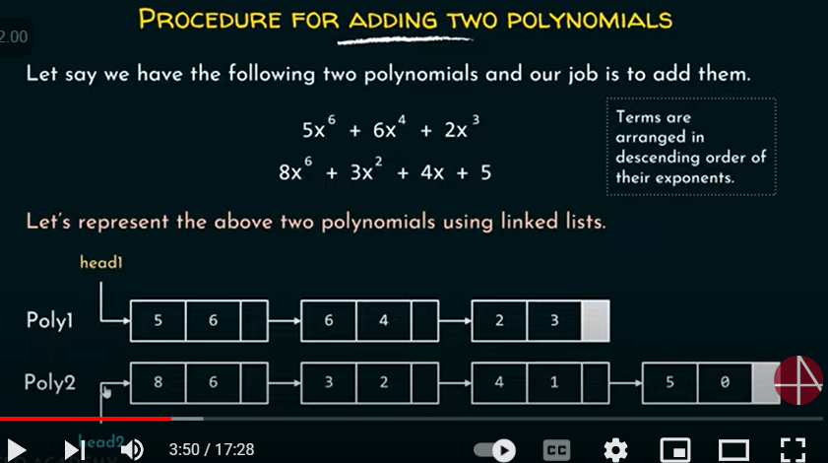

Slide 16
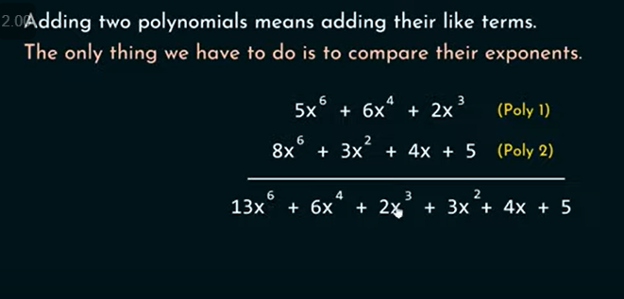

Slide 17
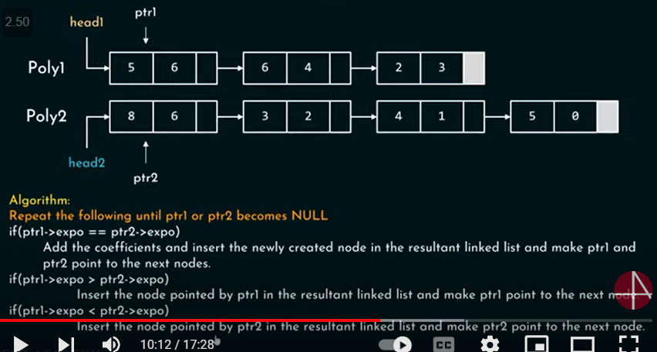

Slide 18
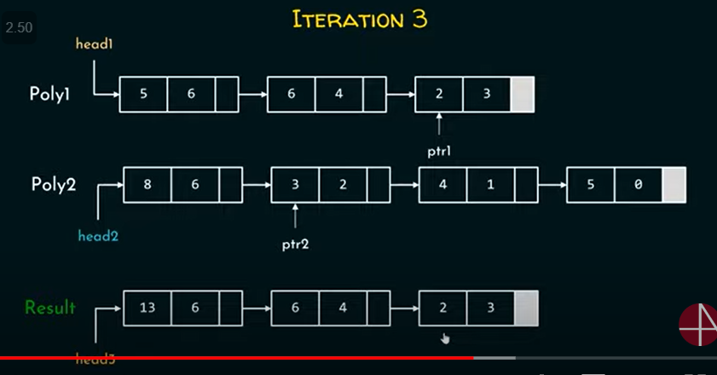

Slide 19
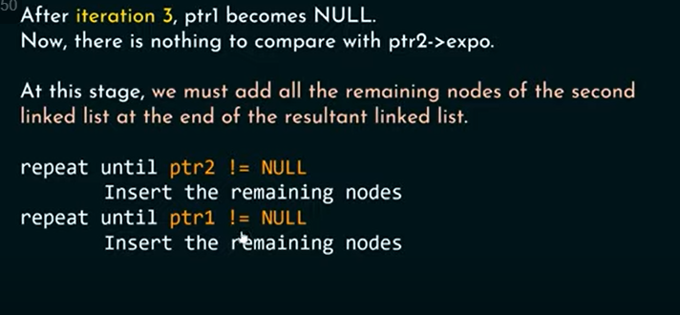

Slide 20
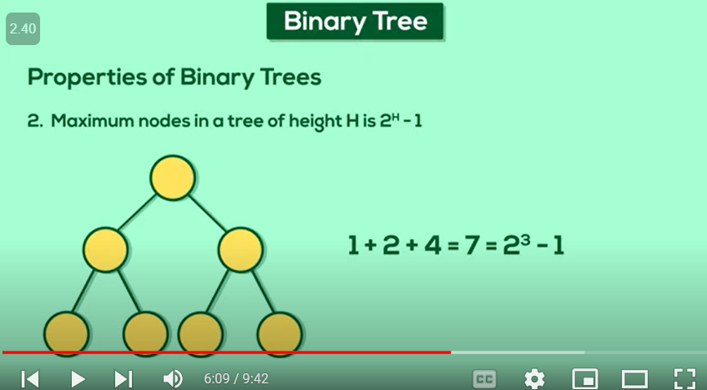
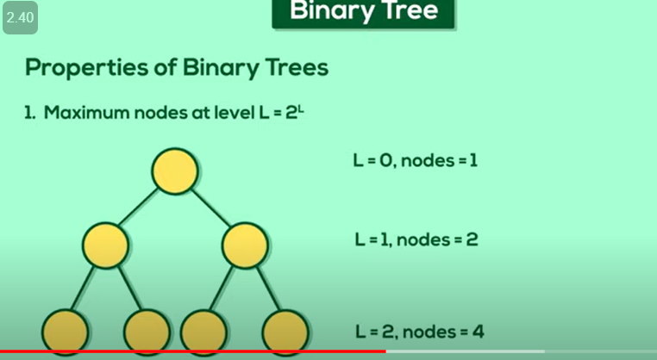

Slide 22
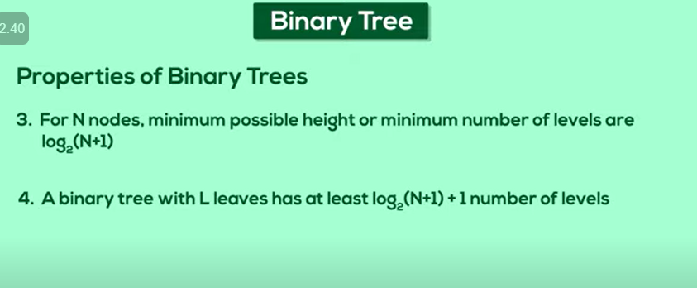

Slide 23
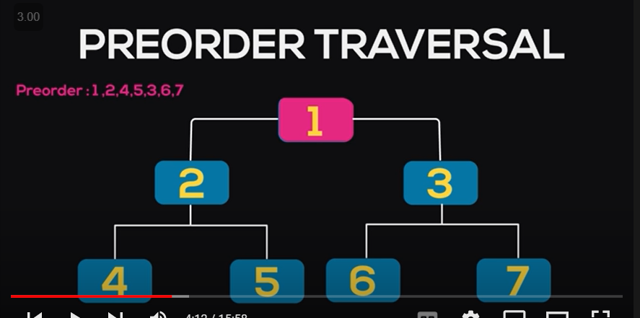

Slide 24
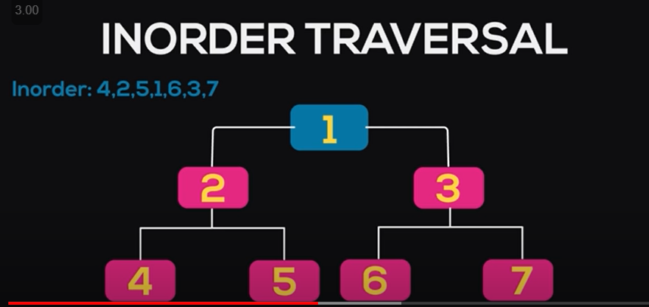

Slide 25
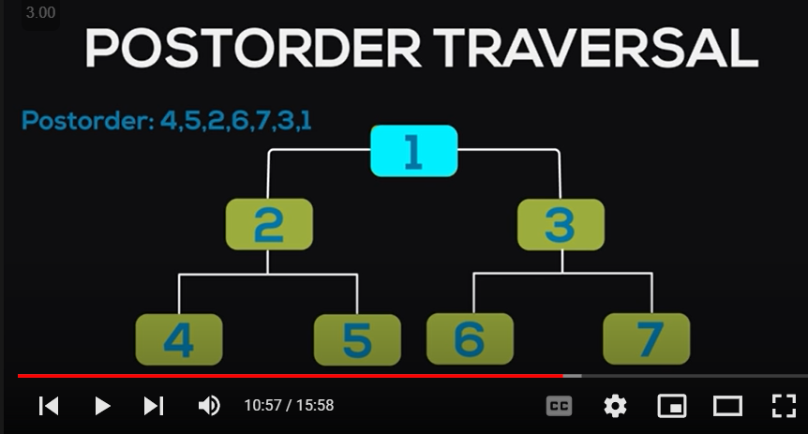

Slide 26
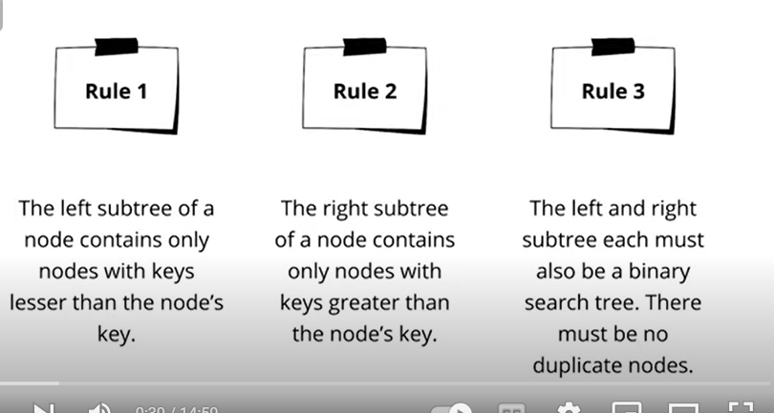

Slide 27
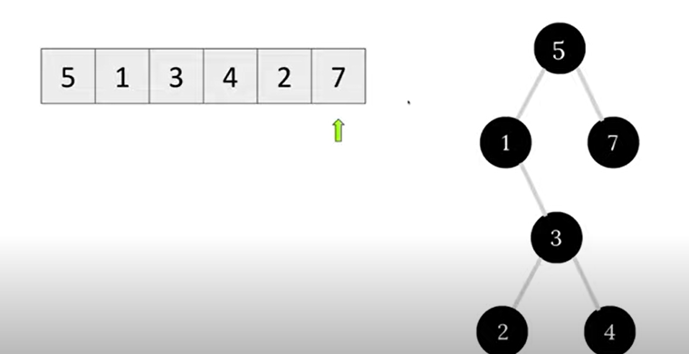

Slide 28
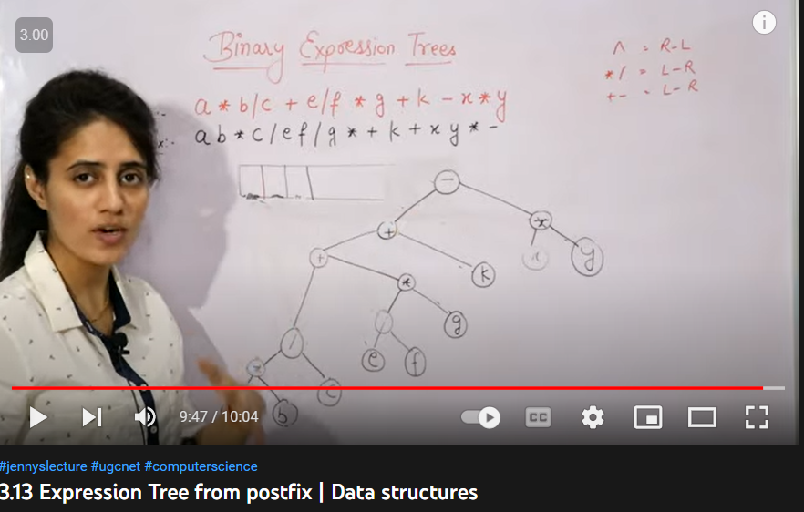

Slide 29
A binary tree in which special nodes are added wherever a null subtree was present in the original tree so that each node in the original tree (except the root node) has degree three

Slide 30
Huffman Coding is a technique of compressing data to reduce its size without losing any of the details. It was first developed by David Huffman.
Huffman Coding is generally useful to compress the data in which there are frequently occurring characters.
Each character occupies 8 bits. There are a total of 15 characters in the above string. Thus, a total of 8 * 15 = 120 bits are required to send this string.
Using the Huffman Coding technique, we can compress the string to a smaller size.
Huffman coding first creates a tree using the frequencies of the character and then generates code for each character.
Once the data is encoded, it has to be decoded. Decoding is done using the same tree.

Slide 31
